Slide 1

Natural Language Processing Course Word Vectors Intuition
Ivo Bernardo – Udemy Course

Slide 2
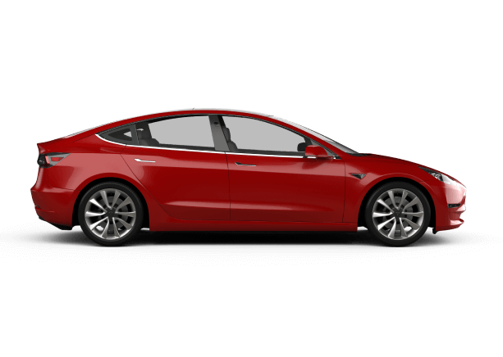
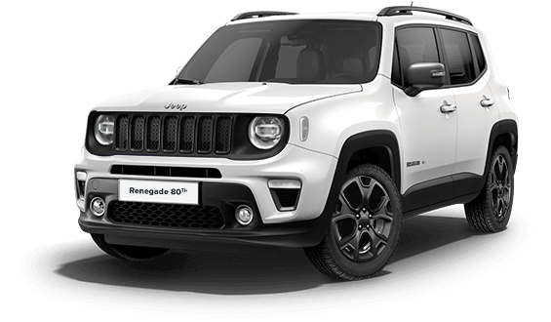
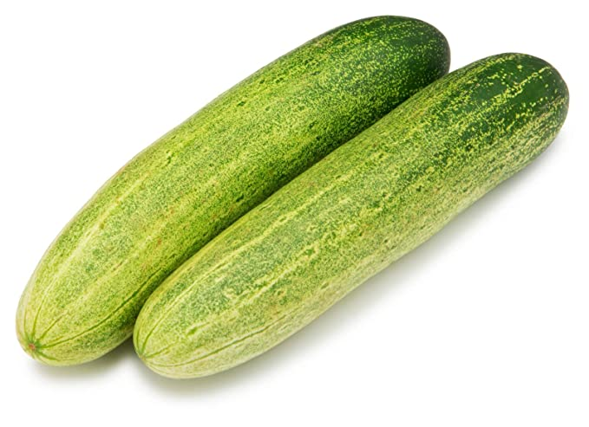
Word Vectors Intuition
Car
Jeep
Cucumber

Slide 3
Word Vectors Intuition – Order Alphabetically
Car
Cucumber
Jeep
No similarity using alphabetical order or the letters of the word!

Slide 4
Word Vectors Intuition – One-Hot Vectors
Main problem: We need to represent words (that represent concepts) mathematically.
Let’s start with a simple approach using one-hot (binary) vectors.
[1, 0, 0]
[0, 1, 0]
[0, 0, 1]

Slide 5
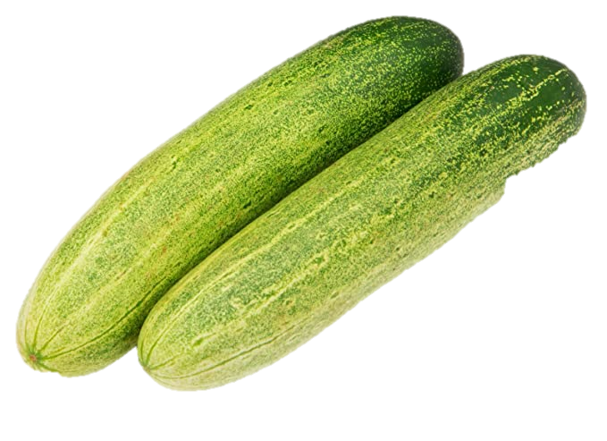
Word Vectors Intuition – One-Hot Vectors
The problem with these simple vectors is that the vectors are orthogonal. This means that they
have no intrinsic relationship between one another. In a 3D Plane:
x, y, z
[1, 0, 0]
[0, 1, 0]
[0, 0, 1]

Slide 6
Word Vectors Intuition – One-Hot Vectors
What we would like is to have the word Car and the word Jeep nearer as they represent similar
concepts!
x, y, z
[?, ?, ?]
[?, ?, ?]
[?, ?, ?]

Slide 7
Word Vectors Intuition – Co-Occurrence Vectors
One idea (and school of thought in the field) is to represent the words based on the context of the
word.
Considering the following sentences – and for the words we want to build vectors to with context* equals to 2 :
I drive a car
I drive a jeep
I ate a cucumber
A cucumber salad
A red jeep
A red car
You shall know a word by the company it keeps!
John Firth - Linguist
* How many neighborhood words we consider in the co-ocurrence

Slide 8
Word Vectors Intuition – Co-Occurrence Matrices
What we would like is to have the word Car and the word Jeep nearer as they represent similar
concepts!
a, car, drive, i
[1, 0, 1, 0]
I drive a car
[0, 0, 0, 0]
[0, 0, 0, 0]

Slide 9
Word Vectors Intuition – Co-Occurrence Matrices
What we would like is to have the word Car and the word Jeep nearer as they represent similar
concepts!
a, ate, car, cucumber, drive, i
[1, 0, 0, 0, 1, 0]
I drive a car
[1, 1, 0, 0, 0, 0]
I ate a cucumber
[0, 0, 0, 0, 0, 0]

Slide 10
Word Vectors Intuition – Co-Occurrence Matrices
What we would like is to have the word Car and the word Jeep nearer as they represent similar
concepts!
a, ate, car, cucumber, drive, i, jeep
[1, 0, 0, 0, 1, 0, 0]
I drive a car
[1, 1, 0, 0, 0, 0, 0]
I ate a cucumber
I drive a jeep
[1, 0, 0, 0, 1, 0, 0]

Slide 11
Word Vectors Intuition – Co-Occurrence Matrices
What we would like is to have the word Car and the word Jeep nearer as they represent similar
concepts!
a
1
a, ate, car, cucumber, drive, i, jeep
[1, 0, 0, 0, 1, 0, 0]
[1, 1, 0, 0, 0, 0, 0]
[1, 0, 0, 0, 1, 0, 0]
ate
1
drive
1

Slide 12
Word Vectors Intuition – Co-Occurrence Matrices
These representations of words are what we commonly call Word Vectors!
a
1
ate
1
drive
1

Slide 13
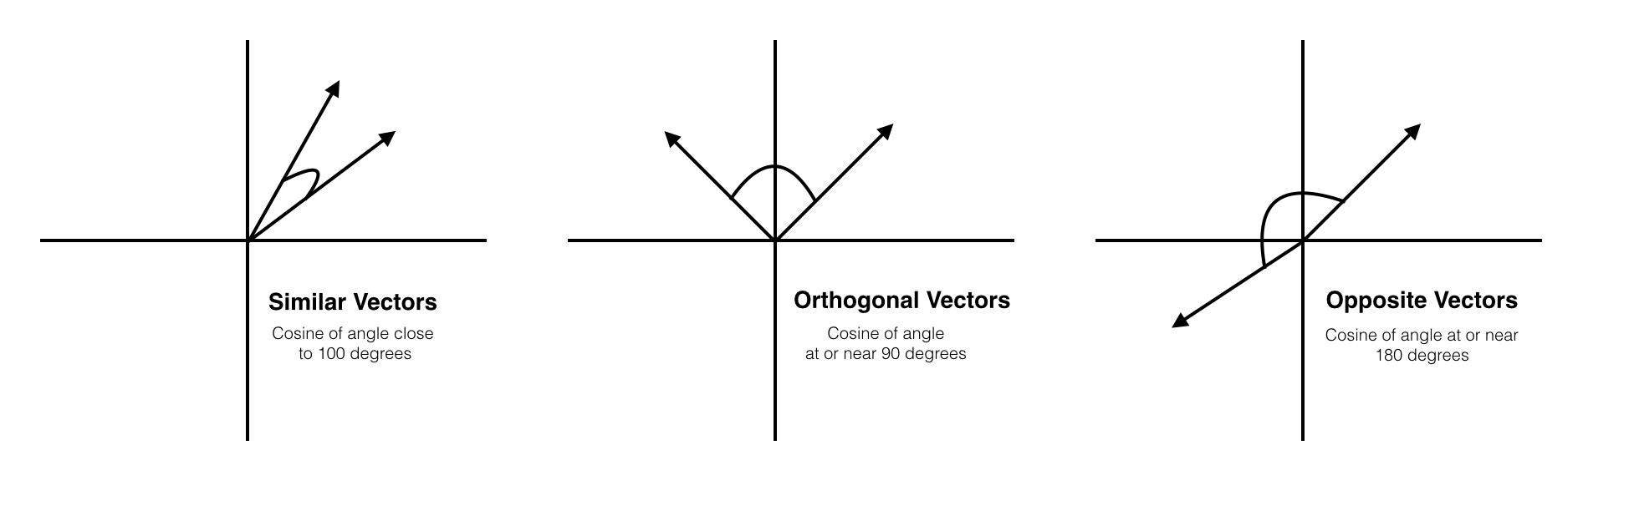
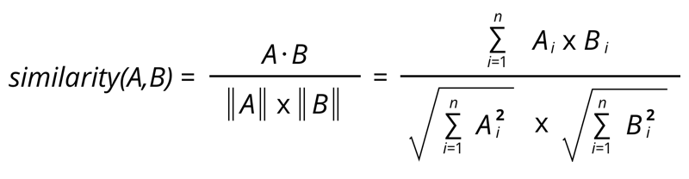
Word Vectors Intuition – Similarity between Vectors
Cosine Similarity Example
Similarity near 1
Similarity near 0
Similarity near -1

Slide 14
Word Vectors Intuition – Co-Ocurrence Matrices and Derivations
Interpretable
Fast to Compute
In derivative approaches it’s easy
to use Probabilistic Models
Relatively bad at capturing analogies

